Slide 1
Customer Transaction Analysis Project
Yash Jajal 501308922
Dec 4, 24

Slide 2
Introduction:
The study researches Australian financial transactions to comprehend consumer behavior and preference for modes of payment.
The results indicate that the age group of 20-30 years leans towards debit cards and online transactions, whereas the age group above 50 relies on credit cards for big-ticket purchases.
The study helps understand consumer financial behavior and shows how data from various transactions can help forecast future trends.

Slide 3
Goals:
Enhance data-driven decision-making.
Optimize performance using advanced models.

Slide 4

Research questions:
What are the spending behaviors and patterns across different demographic segments (such as age and gender) about specific transaction types and merchant categories?
How can demographic and transactional attributes (e.g., age, gender, transaction amount, frequency, card presence) be used to accurately predict the annual salary of consumers?

Slide 5
Data Preprocessing:
Handling missing data using mean/median imputation.
Card Present Flag: 4,326 missing values.
Merchant Code: 11,160 missing values.
Merchant Latitude, Longitude, State, and Suburb: 4,326 missing values each.
Outlier detection via z-scores and IQR methods.
Cleaned features to reduce noise and improve accuracy.

Slide 6
Feature Engineering – Overview:
Selected features based on correlation and importance scores.
Applied one-hot encoding and label encoding for categorical data.
Scaled features to standardize input for model performance.

Slide 7
Replacing the missing values:
Filling missing values using techniques like mean, median, or mode imputation for numerical fields or forward/backward filling for categorical fields.
Filtering out rows with missing values in key columns critical to the analysis, such as transaction or customer details.

Slide 8
Exploratory Data Analysis (EDA):
Visualized distributions with histograms and box plots.
Correlation matrix revealed multicollinearity in key features.

Slide 9
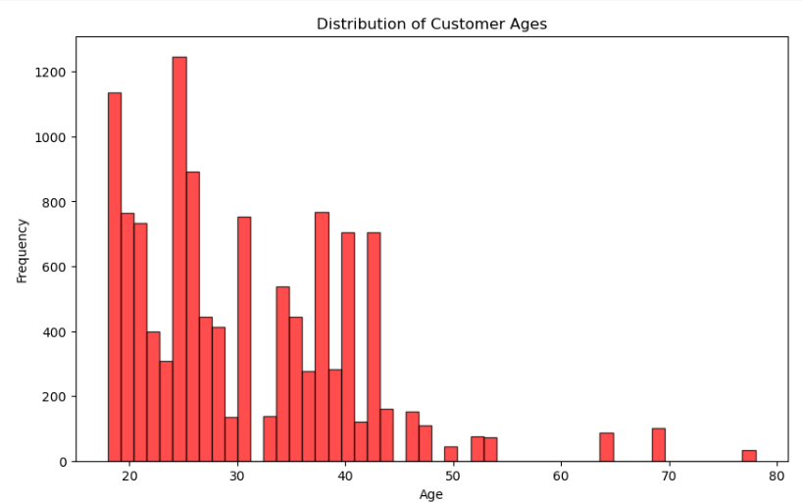
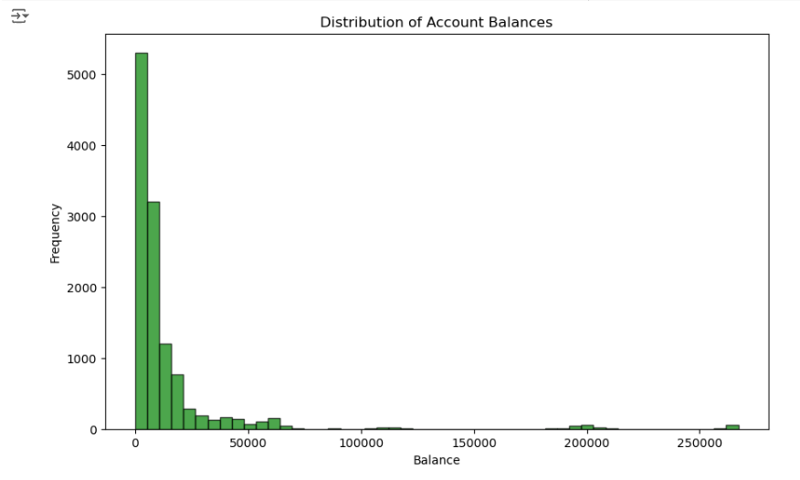
Distribution Plots:
Created histograms and density plots for feature distributions.
Libraries used: Matplotlib and Seaborn.

Slide 10
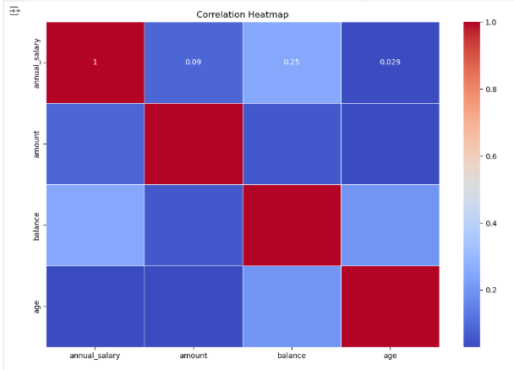
Correlation Analysis:
Generated heatmap of feature correlations.
High correlation observed between Annual Salary and Balance.

Slide 11
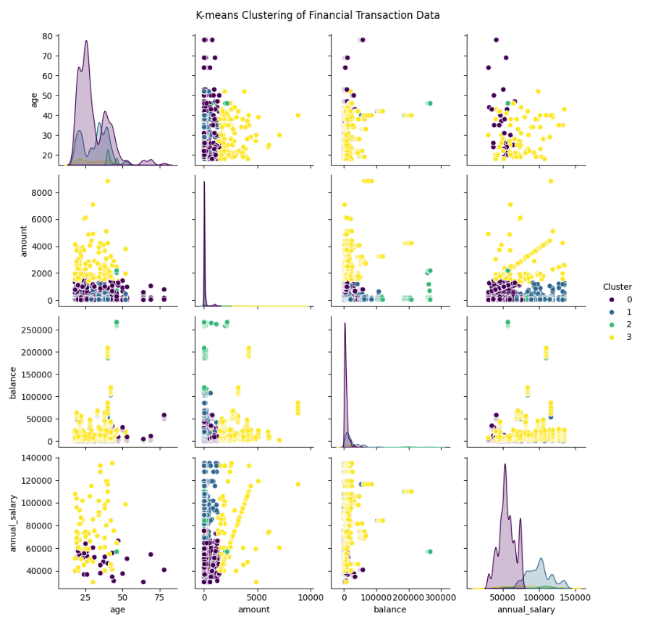
Cluster Analysis (K-Means)(MODEL 1):
Applied K-Means clustering with k = [value].
Visualized clusters to interpret distinct group characteristics.

Slide 12
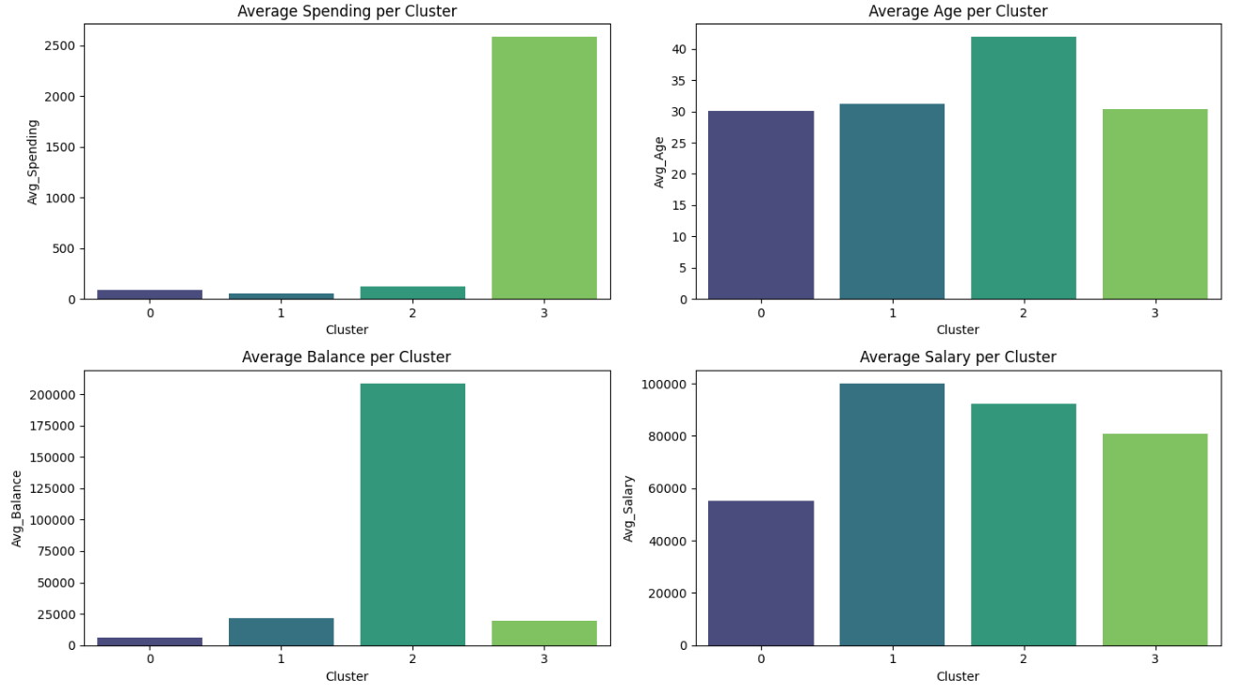
Visualization of Clusters:
Plotted clusters in 2D space.

Slide 13
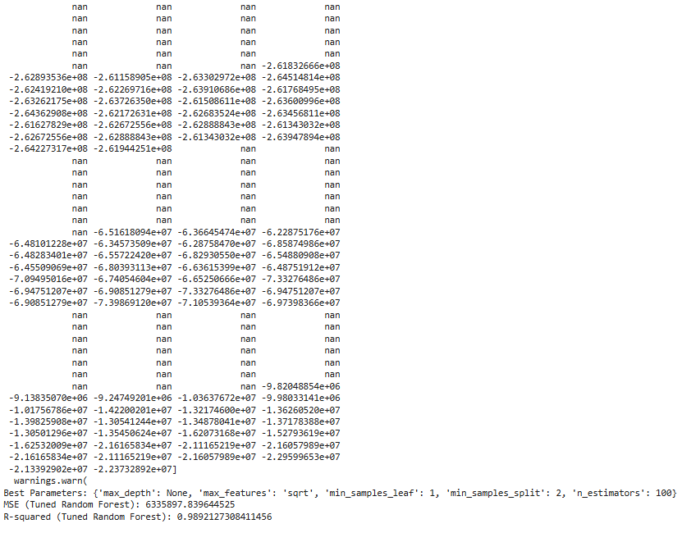
Random Forest(Model 2):
Random Forest architecture with 100 trees.
Hyperparameter tuning using Grid Search.

Slide 14
Model Comparison:
Random Forest: High accuracy, interpretable.
XGBoost: Better at handling imbalanced data.
K-Means: Effective for unsupervised learning.

Slide 15
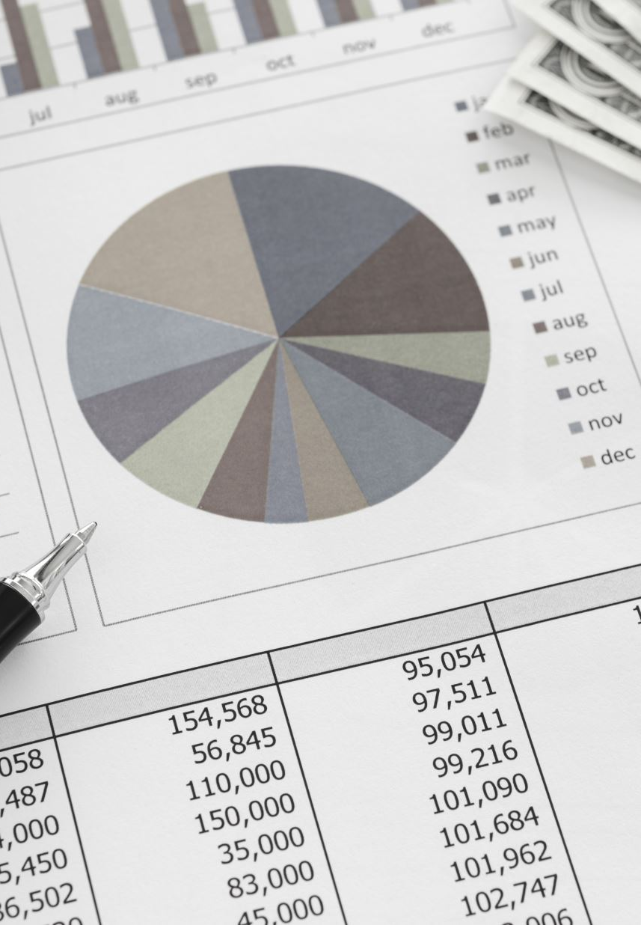
Feature Importance Analysis:
Top features: age, balance, amount, card_present, txn_description,movement, payment_period, dow, latitude ,longitude, merchant_state, merchant_suburb

Slide 16
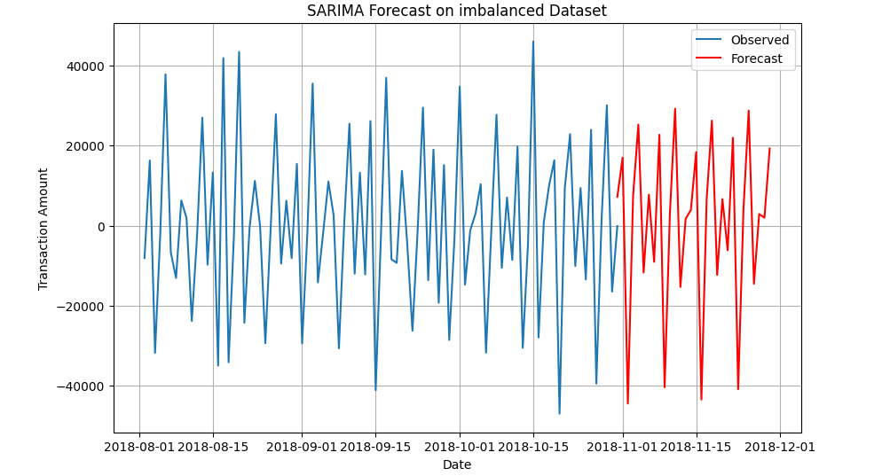
Before facing Challenges:
Imbalanced dataset affected initial model accuracy.

Slide 17
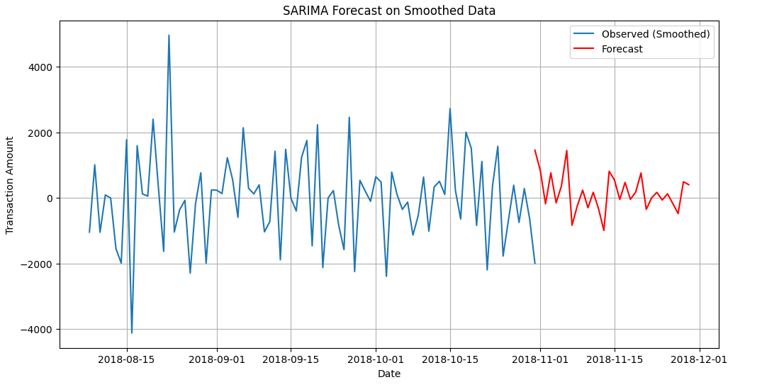
After facing Challenges:
Addressed missing data and noisy features.

Slide 18
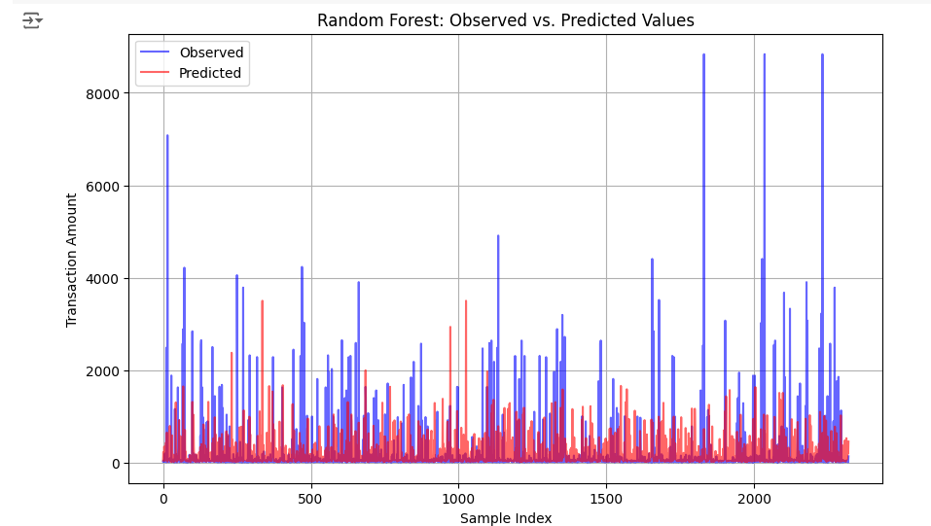
Random Forest BEFORE improving Dataset on Observed and Predicted Values

Slide 19
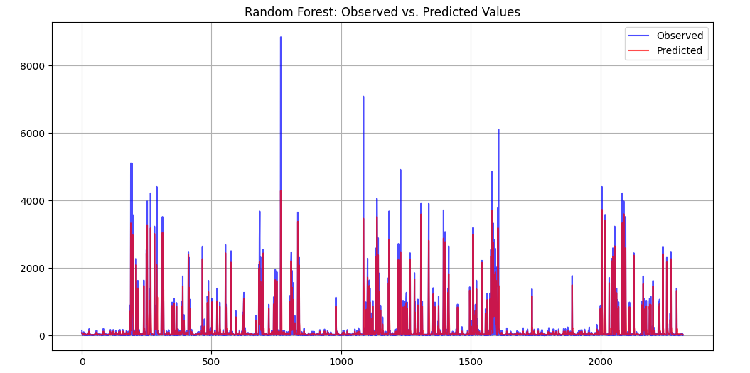
Random Forest AFTER improving Dataset on Observed and Predicted Values

Slide 20
Practical Implications and Business Impact:
1. Improved Consumer Insights:
Understanding consumer preferences based on transaction data helps tailor marketing strategies.
Insights into spending habits enable better customer segmentation.
2. Enhanced Financial Forecasting:
Accurate predictions of annual salary from transactional and demographic data assist in personalized financial products.
Banks and financial institutions can better predict customer creditworthiness.

Slide 21
1. Summary of Achievements: Successfully analyzed consumer transaction behavior and built predictive models. Enhanced understanding of financial data patterns and their practical applications. 2. Future Research: Incorporate additional external data, such as economic indicators, to improve model accuracy. Explore deep learning models for enhanced prediction of financial behaviors.
Closing Remarks and Future Directions:

Slide 22
Thank you for your time!

